Slide 1
valgrind

Slide 2
garbage values

Slide 3
int main(void)
{
int *x;
int *y;
x = malloc(sizeof(int));
*x = 42;
*y = 13;
y = x;
*y = 13;
}

Slide 4
int main(void)
{
int *x;
int *y;
x = malloc(sizeof(int));
*x = 42;
*y = 13;
y = x;
*y = 13;
}

Slide 5
int main(void)
{
int *x;
int *y;
x = malloc(sizeof(int));
*x = 42;
*y = 13;
y = x;
*y = 13;
}

Slide 6
int main(void)
{
int *x;
int *y;
x = malloc(sizeof(int));
*x = 42;
*y = 13;
y = x;
*y = 13;
}

Slide 7
int main(void)
{
int *x;
int *y;
x = malloc(sizeof(int));
*x = 42;
*y = 13;
y = x;
*y = 13;
}

Slide 8
int main(void)
{
int *x;
int *y;
x = malloc(sizeof(int));
*x = 42;
*y = 13;
y = x;
*y = 13;
}

Slide 9
int main(void)
{
int *x;
int *y;
x = malloc(sizeof(int));
*x = 42;
*y = 13;
y = x;
*y = 13;
}

Slide 10
int main(void)
{
int *x;
int *y;
x = malloc(sizeof(int));
*x = 42;
*y = 13;
y = x;
*y = 13;
}

Slide 11
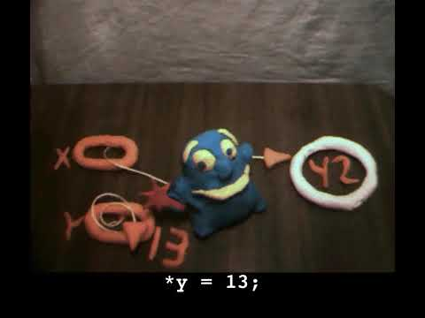

Slide 12
void swap(int a, int b)
{
}

Slide 13
void swap(int a, int b)
{
int tmp = a;
a = b;
b = tmp;
}

Slide 14
void swap(int a, int b)
{
int tmp = a;
a = b;
b = tmp;
}

Slide 15
scope

Slide 16
passing by value

Slide 17
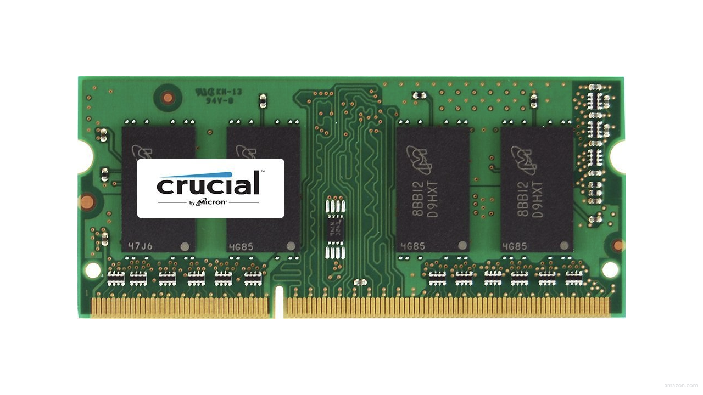

Slide 21
↑
stack

Slide 22
machine code
↑
stack

Slide 23
machine code
globals
heap
↓
↑
stack

Slide 24
machine code
globals
heap
↓
↑
stack

Slide 25
machine code
globals
heap
↓
↑
stack

Slide 26
machine code
globals
heap
↓
↑
stack

Slide 27
machine code
globals
heap
↓
↑
stack

Slide 28
↑
stack

Slide 29
void swap(int a, int b)
{
int tmp = a;
a = b;
b = tmp;
}

Slide 30
main

Slide 31
swap
main

Slide 32
main

Slide 33
x
y

Slide 34
1
x
2
y

Slide 35
swap
1
x
2
y

Slide 36
a
b
tmp
1
x
2
y

Slide 37
1
a
2
b
tmp
1
x
2
y

Slide 38
int tmp = a;
a = b;
b = tmp;
1
a
2
b
tmp
1
x
2
y

Slide 39
int tmp = a;
a = b;
b = tmp;
1
a
2
b
1
tmp
1
x
2
y

Slide 40
int tmp = a;
a = b;
b = tmp;
2
a
2
b
1
tmp
1
x
2
y

Slide 41
int tmp = a;
a = b;
b = tmp;
2
a
1
b
1
tmp
1
x
2
y

Slide 42
2
a
1
b
1
tmp
1
x
2
y

Slide 43
1
x
2
y

Slide 44
passing by reference

Slide 45
void swap(int a, int b)
{
int tmp = a;
a = b;
b = tmp;
}

Slide 46
void swap(int *a, int *b)
{
int tmp = *a;
*a = *b;
*b = tmp;
}

Slide 47
1
x
2
y

Slide 48
a
b
tmp
1
x
2
y

Slide 49
int tmp = *a;
*a = *b;
*b = tmp;
a
b
tmp
1
x
2
y

Slide 50
int tmp = *a;
*a = *b;
*b = tmp;
a
b
1
tmp
1
x
2
y

Slide 51
int tmp = *a;
*a = *b;
*b = tmp;
a
b
1
tmp
2
x
2
y

Slide 52
int tmp = *a;
*a = *b;
*b = tmp;
a
b
1
tmp
2
x
1
y

Slide 53
a
b
1
tmp
2
x
1
y

Slide 54
2
x
1
y

Slide 55
void swap(int a, int b)
{
int tmp = a;
a = b;
b = tmp;
}

Slide 56
void swap(int *a, int *b)
{
int tmp = *a;
*a = *b;
*b = tmp;
}

Slide 57
machine code
globals
heap
↓
↑
stack

Slide 58
heap
↓
↑
stack

Slide 59
heap overflow
stack overflow

Slide 60
buffer overflow

